Slide 1

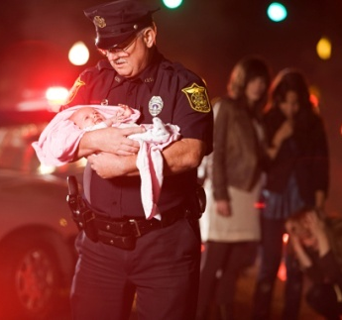
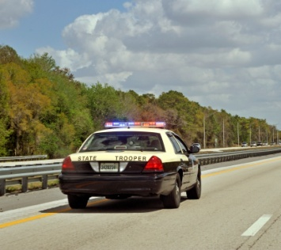
1
Unit 4 Section A
Heroes among us
FOREIGN LANGUAGE TEACHING AND RESEARCH PRESS
AIR FORCE ENGINEERING UNIVERSITY
Notes:
1

Slide 2
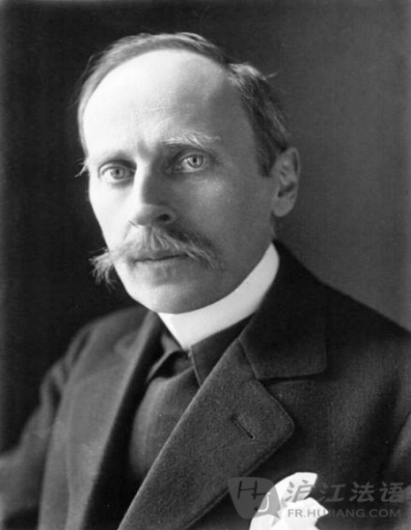
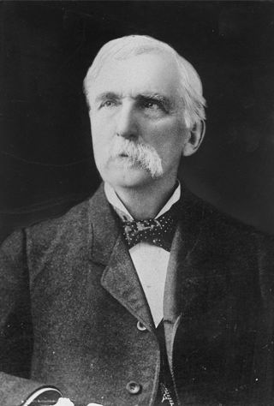
1
4
UNIT
A hero is a man who does what he can.
— Romain Rolland
Heroism is latent in every human soul.
— Joshua Lawrence Chamberlain
Notes:
2

Slide 3

^{Section A}
1
4
Heroes of our time
UNIT
Heroes among us
To talk about heroism
Objectives
To understand the text fully
To apply the phrases and patterns
To master the paragraph writing skill

Slide 4





Heroes among us
Section A
Contents
Warming-up activities
Text study
Language application
Summary

Slide 5



Heroes among us
Section A
Warming-up activities
Lead-in
Pre-reading activities
Cultural background

Slide 6


Short answer questions
1. Who is the greatest hero in your mind? And Why?
Tips
Huang Jiguang, Qiu Shaoyun, Dong Cunrui… (combat heroes who sacrificed their own lives to fulfill the operational mission)
Wu Juping (the most beautiful mother), Zhang Lili (the most beautiful teacher)…(civilian heroes who risked their own lives to save others in modern times)
Mao Zedong, Zhou Enlai,…(great leaders who led Chinese people toward independence and liberation)
Wen Tianxiang, Yue Fei, Qi Jiguang… (national heroes who dedicated their lives to national unity in Chinese history)

Slide 7
Short answer questions
2. What makes a hero in your eyes?
Tips
A good heart
The readiness to lend a hand to people in trouble
The courage to risk one’s own life to help others in danger
The determination to fight for his own country and people

Slide 8


Listening and talking
Listen to a news report about a man named Wesley Austrey and discuss the questions.
1. Do you regard Wesley Austrey as a hero? Why or why not?
2. What would you do if you were at the scene?

Slide 9

Listening and talking
1. Do you regard Wesley Austrey as a hero? Why or why not?
Tips
Yes.
immediately jump onto the tracks
be fully aware of the danger
show unusual courage in time of danger
No.
behave irresponsibly
his two kids were watching him

Slide 10
Listening and talking
2. What would you do if you were at the scene?
Tips
doubt if I would be courageous enough
shout at the man
tell him to stay between the tracks
lower his body and keep his head down

Slide 11


Compound dictation
Listen to a short passage and fill in the missing information.
Every time when I read the five thousand years old Chinese history, I am moved and _________ by those earthshaking heroes. Emperor Qin Shi Huang, Li Shiming, Zhao Kuangyin…I am also a ______ creature of god, and the end product of thousands of years of evolution. Therefore, I am better ________ in both mind and body than all the emperors and wise men who preceded me.
convinced
unique
equipped

Slide 12
Compound dictation
Listen to a short passage and fill in the missing information.
As long as I am crazy, and ______________ the limits, I will have hope. I will never give up a chance of being a hero. Only mediocre people are easily satisfied. I am a mediocre person ____________. Mediocrity is alien to me, just like the fire and water. I will __________ my limits again and again, never allow myself to bring regrets and _______ into my grave.
break through
by no means
challenge
sorrow

Slide 13
Compound dictation
Listen to a short passage and fill in the missing information.
I will never give up a chance of being a hero. Life is only once. Anybody will die no matter what he will do. It may lie in different roads __________ the same ending. While the key to life lies in these different roads, I will walk the journey bravely and rigidly and exert my _________ completely.
leading to
potential

Slide 14
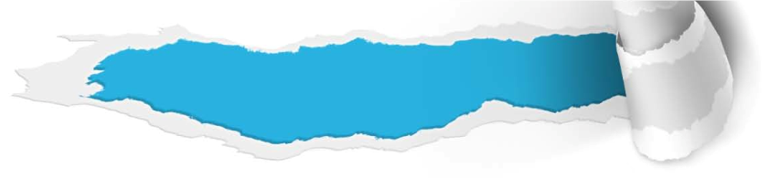
Compound dictation
Listen to a short passage and fill in the missing information.
Great era provides everyone great ______________. My destiny is in my hand. I will try my best to carry forward my life. There is only one self in the world. I will walk only once in this world. I will never give up a chance of being a hero.
opportunities

Slide 15
Cultural background
Questions previewing
1. Who is Nelson Mandela? Why was he so famous?
2. What is Greg’s Law? Why is it named after a person?

Slide 16



Nelson Mandela
Who is Nelson Mandela? Why was he so famous?
Tips
be arrested and sentenced to life in prison
serve 27 years in prison
lead his party to end apartheid after his release
bring about a peaceful transition to nonracial democracy in South Africa
receive the 1993 Nobel Peace Prize
the first black President of South Africa
an anti-apartheid activist
the leader of the armed wing of the African National Congress

Slide 17

Greg’s Law
2. What is Greg’s Law? Why is it named after a person?
Tips
be passed in 2009 as part of a larger Road Safety Bill
target motorists who drive while suspended, unlicensed and uninsured
introduce stricter sentencing, including a seven-day vehicle impoundment (扣押).
in memory of police officer Greg Stobbart, who was tragically killed while riding his bike

Slide 18

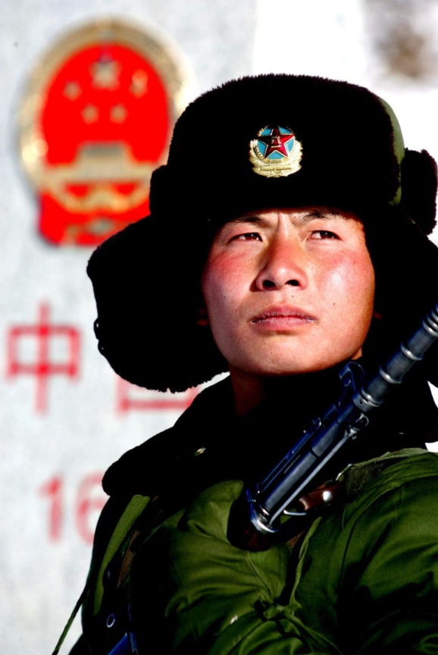
Heroes among us
Section A
Text study
Main idea & structure
Language focus
Critical thinking

Slide 19

Main idea & structure
Main ideas of the parts
What thesis statement does the author make about heroes today? (Para.1)
Tips
The word“hero” becomes more common and is used to refer to both victims and survivors of all kinds of difficulties and tragedies.

Slide 20
Main idea & structure
Main ideas of the parts
What question does the author raise afterwards? (Para.1)
Tips
Who are the heroes among us?
Notes:
20

Slide 21

Main idea & structure
Main ideas of the parts
Part I — (Para.1)
Today the word “hero” becomes more ________ and is used to refer to both _______ and ________ of all kinds of difficulties and tragedies.
common
victims
survivors

Slide 22
Main idea & structure
Main ideas of the parts
What examples of heroic deeds does the author provide in Para. 2 and 3?
Tips
Daniel Hernardez
Para 2: _________________, who ran through danger in a mass shooting and saved the life of his boss and friend, Gabrielle Giffords.
Para 3: _______________, who saved his wife by shielding her from the hail of bullets in the mass shooting.
Dory Stoddard
Notes:
22

Slide 23
Main idea & structure
Main ideas of the parts
What conclusion does the author draw from the two examples? ( Para.4)
Tips
They are civilian heroes.

Slide 24
Main idea & structure
Main ideas of the parts
Part II — (Paras. 2-4)
Both Daniel and Dory are _______ heroes as they acted instinctively with ________ and ______ when situations call for.
civilian
courage
grace

Slide 25
Main idea & structure
Main ideas of the parts
Structure (Paras. 1-4)
Question
Examples
Conclusion

Slide 26

Main idea & structure
Main ideas of the parts
What is the question raised by the author in Para. 5?
Tips
Are first responders considered heroes, too?
Question-Example-Conclusion Pattern
What is the example of first responders? (Para. 6)
Tips
Sergeant Ryan Russell, who tried to stop a drunk driver in a stolen snowplow with only his police car and his good will to help others, and was killed.
First responders are also honored as heroes.
Conclusion(implied):
Notes:
26

Slide 27
Main idea & structure
Main ideas of the parts
According to the writer, what were heroes in the past? (Para. 7)
Tips
These people were called heroes because they performed acts of _____________________.
extraordinary courage

Slide 28
Main idea & structure
Main ideas of the parts
What are heroes nowadays? (Para.8)
Tips
average
Nowadays, our heroes are ________ men and women.
Comparison
and
Contrast
Paragraph 7
Paragraph 8
Notes:
28

Slide 29
Main idea & structure
Main ideas of the parts
Question: Do first responders who fail to achieve their goals in their efforts become heroes? (Para. 9)
Example: Eleanor McMahon was sure that Sgt. Russell was indeed a hero because he showed distinct courage when trying hard to stop the snowplow before it hurt others. She strongly argued: It’s natural for civilians to rush toward safety and away from danger. But heroes of first responders rush toward danger to help those in need. (Paras. 10-11)
Question-Example-Conclusion Pattern
Conclusion: We expect first responders to rush forward, especially when we or our loved ones are in danger. So when they die doing that, we should recognize their heroic efforts. (Para. 12)

Slide 30
Main idea & structure
Main ideas of the parts
Para. III — (Paras. 5-12)
First responders are heroes no matter they succeed in their effort to save people or get injured or killed in their efforts.

Slide 31


Main idea & structure
Main ideas of the parts
Listen to the conclusion for the whole text and fill in the blanks. (Para. 13)
Tips
inspiring
The _________ stories of heroes, both civilian heroes and first responders, show that ordinary people can do ____________ things whether they are carrying out their duties, or as part in their daily life. We should not only ______ them, but also change the situations that may lead to their death. We should try to act heroically if ______________ call on us.
extraordinary
honor
circumstances
Notes:
31

Slide 32
Main idea & structure
Main ideas of the parts
Para. IV — (Para. 13)
The stories of heroes help remind us that ordinary people can do extraordinary things and, being inspired by them, we can also be heroes when circumstances call on us to act heroically.

Slide 33
Main idea & structure
Main idea of the passage
Text A is an essay on people’s view about what makes a hero. It is pointed out that in the past the word “hero” was reserved for those who performed acts of courage beyond the call of duty or for great leaders, while today heroes can be ordinary people like us. Besides, first responders, whose duty is to rush toward danger, are also heroes, even when their efforts failed to bring about desirable effects. Hopefully, we will also act heroically when circumstances call on us.

Slide 34
Main idea & structure
Structure of the text
Question
Example 1 (civilian heroes)
Conclusion: Both Daniel and Dory are civilian heroes as they acted instinctively with courage and grace when situations call for.
1.Daniel Hernardez saved his boss and friend.
2.Dory Stoddard saved his wife.

Slide 35
Main idea & structure
Structure of the text
Question
Example 1 (civilian heroes)
Example 2 (First responder heroes)
First responders are also honored as heroes as can be seen from the example of Sergeant. Ryan Russell.
Heroes in the past were those who performed acts of extraordinary courage while today heroes are average men and women.
We expect first responders to rush toward danger. So when they die doing that, we should recognize their heroic efforts.

Slide 36
Main idea & structure
Structure of the text
Question
Example 1 (civilian heroes)
Example 2 (First responder heroes)
Conclusion
The encouraging stories of heroes, both civilian heroes and first responders, show that ordinary people can do heroic things. We should not only honor them, but also change the situations that may lead to their death. We should try to act heroically if circumstances call on us.

Slide 37
Main idea & structure
Structure of the text
Question
Examples
Conclusion

Slide 38
Main idea & structure
Summary of the text
In an era of heightened heroism, who are the heroes among us?
They can be ordinary people like Daniel Hernandez who ran through danger in a mass shooting to save his boss and Dory Stoddard who saved his wife by ________ her from the hail of bullets. Both of them are ______ heroes as they acted with courage and grace when __________ extraordinary circumstance.
shielding
civilian
caught up in

Slide 39
Main idea & structure
Summary of the text
Then are first responders considered heroes, too? We get the answer from Sergeant. Ryan Russell, who got killed in his efforts to help others but was _______ by thousands of other emergency responders. In the past the word “hero” was _______ for those who performed acts of distinct courage beyond the call of duty or for great leaders, while today heroes can be ordinary people like us. Then, do first responders who ___ to bring about
honored
reserved
fail

Slide 40
Main idea & structure
Summary of the text
desirable results also become heroes? Ms. McMahon provided the right answer. She strongly argued that it’s ______ for civilians to rush away from danger. In contrast, first responders rush toward danger to help those ______. So when first responders die doing that, we should _________ their heroic efforts. Ordinary people can do extraordinary things and, being _______ by them, we can also be heroes when circumstances call on us to act heroically.
natural
in need
recognize
inspired

Slide 41
Language focus
Practical phrases
Practical Phrases | Meanings
1. apply pressure to / on | 按压，给…施加压力
2. shield sb. from sth. | 使……免受……
3. be/get caught up in | 被卷入；陷入
4. reserve sth. for sb. / sth. | 保留；预留
5. relate to sth. / sb. | 理解；认同
6. make sense of sth. | 理解，弄懂某事
7. give authority to | 授权
8. count on | 依靠；指望

Slide 42

Language focus
Practical phrases
按压，给…施加压力
短语逆译
apply pressure to/on
短语应用
你可以按压伤口让血流的慢些。
意群提示
(injury / bleed)
You can apply pressure on the injury to make the blood bleed slower.

Slide 43
Language focus
Practical phrases
使… …免受… …
短语逆译
shield sb. from sth.
短语应用
保护祖国不受侵略是军人的职责。
意群提示
(shield … from… / invasion / servicemen)
It is the duty of servicemen to shield their country from invasion.

Slide 44
Language focus
Practical phrases
被卷入；陷入
短语逆译
be/get caught up in
短语应用
那些被卷入游行示威的学生的安全必须得到保证。
意群提示
(be caught up in / demonstration/ be guaranteed)
The safety of those students caught up in the demonstration must be guaranteed.

Slide 45
Language focus
Practical phrases
reserve sth. for sb./sth.
保留；预留
短语逆译
短语应用
这个问题必须留待进一步讨论。
意群提示
(reserve for / further discussion )
This question must be reserved for further discussion.

Slide 46
Language focus
Practical phrases
理解；认同
短语逆译
relate to sth./sb.
短语应用
我知道他的求职申请被拒后他很沮丧。我能理解他的感受。
意群提示
(job application/ reject/be frustrated/ relate to )
I know he was very frustrated when his job application was rejected. I can relate to that.

Slide 47
Language focus
Practical phrases
理解，弄懂某事
短语逆译
make sense of sth.
短语应用
我无法搞懂他为什么在最后一刻放弃比赛。
意群提示
(make sense of/ competition)
I can’t make any sense of his giving up the competition at the last minute.

Slide 48
Language focus
Practical phrases
授权
短语逆译
give authority to
短语应用
合同授权研究人员使用实验室里的任何东西。
意群提示
The contract gives authority to research members to use anything in the laboratory.
(contract/give authority to/research members)

Slide 49
Language focus
Practical phrases
依靠；指望
短语逆译
count on
短语应用
他们决定不依靠外援来缓解饥荒。
意群提示
(count on/foreign aid/ relieve/famine)
They decided not to count on foreign aid to relieve the famine.

Slide 50
Language focus
Functional patterns
Functional patterns | Functions & usages
1. It used to be that … | 用于表达“过去的某一习惯或情况现在已不存在”，表示与目前习惯或情况有所不同。
2. Sb./Sth. is …. So is sb./sth. else/So are some other people/some other things. | 用于表达“人或事物之间的相似之处” 。
3. Sb. do sth., especially when…. | 用于表达“某人最有可能做某事的一种条件”。
4. Sb. do sth. by…. Perhaps, even more importantly, sb. do sth. by… | 用于表达“对某人而言更为重要的行为方式”。
Notes:
50

Slide 51

Language focus
Functional patterns
原句译文
在过去，“英雄”一词仅限于称呼那些做出超乎职责范围的特别英勇的行为的人们。
逆译练习
It used to be that the word hero was reserved for those who performed acts of distinct courage beyond the call of duty.
句型提炼
Notes:
51

Slide 52
Language focus
Functional patterns
句型提炼
It used to be that …
应用提示
用于表达“过去的某一习惯或情况现在已不存在”，表示与目前习惯或情况有所不同。
句型应用
Notes:
52

Slide 53
Language focus
Functional patterns
典型例句
在过去，只有享受至高无上权利的皇家才能使用龙的形象。
意群提示
( supreme power/image)
It used to be that the image of dragon could only be used by royal families that enjoyed the supreme power.

Slide 54
Language focus
Functional patterns
原句译文
一位战士冒着枪林弹雨去抢救其他战友，他被看作英雄。同样，超凡卓越的具有传奇色彩的领袖人物也是英雄，比如纳尔逊· 曼德拉。被囚禁于单人牢房27年后，曼德拉终于摆脱了牢狱生活。
逆译练习
A soldier who runs through gunfire to rescue other military personnel is seen as a hero. So are larger-than-life leaders such as Nelson Mandela, who emerged after 27 years of jail, confined in a solitary chamber.
句型提炼
Notes:
54

Slide 55
Language focus
Functional patterns
句型提炼
Sb./Sth. is …. So is sb./sth. else./ So are some other people/some other things.
应用提示
用于表达“两个人或事物之间的相似之处”。
句型应用
Notes:
55

Slide 56
Language focus
Functional patterns
典型例句
在你的人生中，通过不懈努力取得的成功是宝贵的财富。同样，帮助你逐步走向成熟的人生挫折也是财富。
意群提示
(painstaking efforts/ valuable asset/setback )
Success that you achieve through painstaking efforts is seen as valuable asset in your life. So are the setbacks that help you to become mature gradually.

Slide 57
Language focus
Functional patterns
原句译文
我们指望应急人员冲向危险，尤其是当我们自身或我们所爱的人身处险境时。
逆译练习
We count on first responders to rush toward danger, especially when it involves us or those we love.
句型提炼
Notes:
57

Slide 58
Language focus
Functional patterns
句型提炼
Sb. do sth., especially when….
应用提示
用于表达“某人最有可能做某事的一种条件”。
句型应用
Notes:
58

Slide 59
Language focus
Functional patterns
典型例句
我喜欢回忆过去，特别是当孤寂来袭之时。
意群提示
(recall/ strike)
I love recalling the past, especially when loneliness strikes.

Slide 60
Language focus
Functional patterns
原句译文
我们向消防队员、警察和普通平民致敬，赞扬其英雄精神。也许，甚至更为重要的是，我们要通过努力改变让他们遭遇不幸的环境来向他们致敬。
逆译练习
We honor the fireman, the policeman, and the average citizen by recognizing their heroism. Perhaps, even more importantly, we honor them by working to change the circumstances that led to their death.
句型提炼
Notes:
60

Slide 61
Language focus
Functional patterns
句型提炼
Sb. do sth. by… . Perhaps, even more importantly, sb. do sth. by…
应用提示
用于表达“对于某人而言更为重要的行为方式”。
句型应用
Notes:
61

Slide 62
Language focus
Functional patterns
典型例句
我们通过传授知识培养学生，也许，更为重要的是，我们通过传授学习方法培养学生。
意群提示
(impart knowledge )
We cultivate students by imparting knowledge. Perhaps, even more importantly, we cultivate students by teaching them learning methods.

Slide 63



Language focus
Language appreciation
在一个英雄主义发扬光大的时代，“英雄”一词已经变得更加常见。
a. In an era of heightened heroism, the word hero has become more common. (Para. 1, L1)

Slide 64
Language focus
Language appreciation
他用温柔体贴的话语安慰她，告诉她他会把她的丈夫和父母找来，告诉她一切都会好的。
b. He spoke tender words of sympathy, telling her that he would find her husband and her parents and that everything would be fine. (Para. 2, L5)

Slide 65
Language focus
Language appreciation
一听到枪声，多利马上扑在妻子身上为她挡住扫射过来的子弹。
c. … when Dory heard shots ring out he immediately fell on top of his wife to shield her from the hail of bullets. (Para. 3, L2)

Slide 66
Language focus
Language appreciation
在加拿大多伦多市，11,000多名警察和其他应急人员肃穆地在大街上游行，纪念一位具有高度保护和服务意识的“好男人和好警察”、35岁的瑞安· 罗素警佐。当时整个市中心的其他活动都停止了。
d. In Toronto, Canada, downtown life stopped when more than 11,000 police and other emergency responders marched solemnly through the streets to honor policeman, Sergeant Ryan Russell, a 35-year-old “good man and good cop”, who believed deeply in his commitment to protect and serve. (Para. 6, L1)

Slide 67
Language focus
Language appreciation
他没有抱怨，作为南非第一位黑人总统，他努力奋斗，致力于创建和谐国家，促进社会化解以往的矛盾。
e. He made the choice not to be bitter, and worked hard as South Africa’s first black president to establish harmony and helped society reconcile its conflicted past. (Para. 7, L4)

Slide 68
Critical thinking
Theme exploration
How do you define a hero?
Do you think people who give their life to save their family members should be considered heroes? Why or why not?
What do you think we should do to honor heroes?

Slide 69

Critical thinking
Theme exploration
How do you define a hero?
Tips
In my view, a hero is someone who:
• is brave or even risks their life in face of danger;
• saves others in trouble;
• shows great courage when others hesitate or fear;
• sacrifices themselves for others.

Slide 70
Critical thinking
Theme exploration
2. Do you think people who give their life to save their family members should be considered heroes? Why or why not?
\\
Tips
Yes, people who give their life to save others should certainly be considered heroes, no matter whom they save — whether it is their family member or a stranger. By rescuing others, they demonstrate extraordinary courage and demonstrated the rare qualities of a hero. These heroic qualities include:
putting themselves in danger to protect others;
fearing no danger or death; and
never regretting their own loss.

Slide 71
Critical thinking
Theme exploration
3. What do you think we should do to honor heroes?
Tips
To honor heroes, we can:
• spread their names and stories in legends, stories, media, songs, movies, etc.;
• put up monuments for commemoration;
• name different places after heroes;
• set up a special day to remember them;
• take good care of them and their families;
• give them special honors; and
• call on society to learn from them.

Slide 72

Critical thinking
Culture exploration
Watch a piece of video clip “What Makes a Hero” and discuss the following questions.
What is hero’s journey according to the video?
What message do you get from the video?

Slide 73
Critical thinking
Culture exploration
Background information
Joseph John Campbell was an American mythologist, writer and lecturer, best known for his work in comparative mythology and comparative religion. His famous book The Hero with a Thousand Faces retells dozens of stories and explains how each represents the hero’s journey.
Katniss Everdeen is a fictional character and the protagonist of Suzanne Collins' The Hunger Games trilogy.
Frodo Baggins is a fictional character in J. R. R. Tolkien’s The Lord of the Rings.

Slide 74
Critical thinking
Culture exploration
1. What is hero’s journey according to the video?
Tips
Hero’s journey is compared to a cycle, which begins and ends in the hero’s ordinary world, but the quest passes through an unfamiliar, special world. Along the way, there are some key events including status quote, call to adventure, assistance, departure, trials, approach, crisis, treasure, result, return, new life, resolution. And then, the cycle starts over again. Many books and movies follow this pattern.

Slide 75
Critical thinking
Culture exploration
2. What message do you get from the video?
Tips
Just as Joseph Campbell said, “in the cave you fear to enter lies the treasure you seek”. When facing problems that are scary in our lives, we need to listen to the call for adventure, accept the challenge, conquer the fear and finally we will claim the treasure we seek.

Slide 76

Critical thinking
Watching & discussing
Watch the MV Hero and discuss the following questions.
1 What is the most important message conveyed in the lyrics?
2 Do you agree that “Heroism is latent in every human soul”? Why or why not?

Slide 77
Critical thinking
MV watching & discussing
1 What is the most important message conveyed in the lyrics?
Tips
There is a hero that lies in everybody’s heart. So just look inside yourself and be strong when faced with difficulties. You can survive all the hardships.

Slide 78
Critical thinking
MV watching & discussing
2 Do you agree that “Heroism is latent in every human soul”? Why or why not?
Tips
Yes, I agree with Joshua Lawrence Chamberlain on the point that “heroism is latent in every human soul”. I think everyone, kids or adults, men or women, wants to be a hero. Some want to be a hero because they want to be respected or loved by others; they would like to gain fame or attention. Some want to be a hero because they want to feel powerful for themselves. Others want to be a hero simply because they want to help those in need, even by sacrificing their own interest, health or life. No matter what motivates the hero, it is a glorious feeling when others look up to you as a hero.

Slide 79
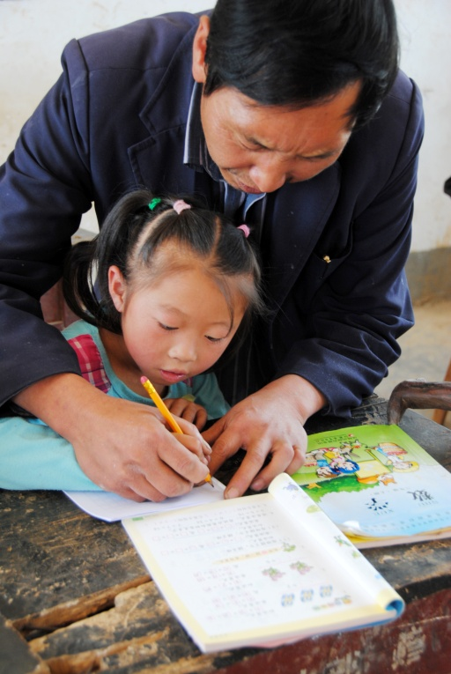

Heroes among us
Section A
Language application
Writing devices
Essay writing
Paragraph translation

Slide 80
Writing devices
Sentence writing
Attributive clause introduced by “who”：
Giving a detailed description to a person is sometimes necessary when you are relating a story, or narrating an event. In this case, attributive clause introduced by “who” serves the purpose quite well. It helps to achieve completeness and vividness of your description.

Slide 81
Writing devices
Sentence writing
Example:
1) These are civilian heroes, who acted instinctively with courage and grace when caught up in extraordinary circumstances.
2) A soldier who runs through gunfire to rescue other military personnel is seen as a hero.

Slide 82

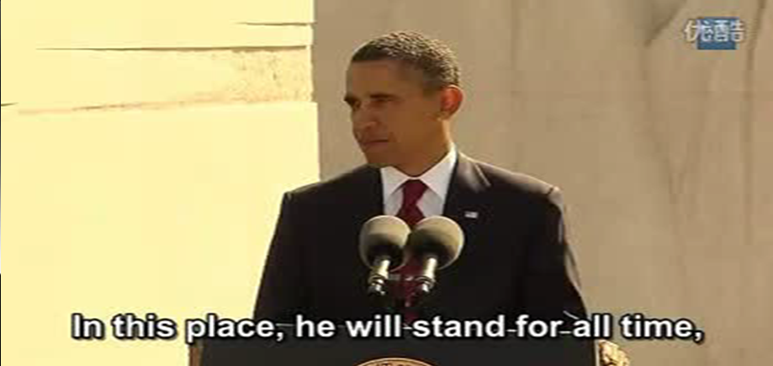
Writing devices
Sentence writing
Appreciation
President Obama at MLK Memorial Dedication

Slide 83
Writing devices
Sentence writing
Appreciation
In this place, he (Martin Luther King Jr.) will stand for all time, among monuments to those who fathered this nation and those who defended it; a black preacher with no official rank or title who somehow gave voice to our deepest dreams and our most lasting ideals, a man who stirred our conscience and thereby helped make our union more perfect. And Dr. King would be the first to remind us that this memorial is not for him alone.…
And finally, there are the multitudes of men and women whose name never appear in the history books — those who marched and those who sang, those who sat in and those who stood firm, those who organized and those who mobilized — all those men and women who through countless acts of quiet heroism helped bring about changes few thought were even possible.
For more

Slide 84

Writing devices
Sentence writing
Practice
Only those candidates（在学业、身体及领导才能上有足够潜质）___________________________________________ ___________________ receive appointments to the Military Academy.
who have enough academic, physical and leadership potential
There is more eye contact between people who like each other than those（对彼此冷漠或有敌意）____________________________ ___________________.
who are indifferent or hostile towards each other

Slide 85
Writing devices
Paragraph writing
Question
Example
Conclusion
For more

Slide 86

Writing devices
Paragraph writing
Directions: Have a look at the outline below and the sample paragraph, which starts with a question supported by an example.

Slide 87
Writing devices
Paragraph writing
Question: What is culture shock?
Example: Mr. Li’s experience on a bus in the US
Factor 1:
Mr. Li meant to give his seat to an elderly man on a bus.
Factor 2:
The elderly man refused to take the seat.
Factor 3:
His American friends explained why.
Conclusion: Culture shock is the feeling of confusion and anxiety when you encounter situations where the cultural norms in your culture no longer apply.

Slide 88

Writing devices
Paragraph writing
Sample paragraph:
What is culture shock? (Question) When he first visited the US, Mr. Li was confused on a bus: He meant to give his seat to an elderly man, but the man seemed annoyed and refused to take the seat. Later his American friends explained to him that in the US it is not advisable, and even offensive, to offer your seat to elderly people. This is very different from China, where people are encouraged to do so. (Example)

Slide 89
Writing devices
Paragraph writing
Sample paragraph:
From the example we can see that culture shock is the feeling of confusion and anxiety when you encounter situations where the cultural norms in your culture no longer apply. (Conclusion)

Slide 90

Writing devices
Paragraph writing
Writing practice
Directions: Write a paragraph on the following topic. You can follow the outline given below.

Slide 91
Writing devices
Paragraph writing
Question: Where does happiness come from?
Example: Ann’s experience with her community members
Factor 1:
Ann, a worker of low income, was devoted to the community.
Factor 2:
Ann was touched and felt grateful when many people came to help her when she was in trouble.
Conclusion: Happiness is the result of helping each other.

Slide 92

Essay writing
Write an essay entitled “A Great Hero in My Mind” by following the writing pattern of the text. You may apply as many expressions from the text as possible to your writing.

Slide 93
Essay writing
You can follow the outline given below.
Beginning part: Thesis Statement and Question
1. Who is the great hero in your mind;
2. A question related to the topic;

Slide 94
Essay writing
You can follow the outline given below.
Body part: Examples
A few inspiring stories to illustrate your point;
Concluding part
1. Restatement of the main idea;
2. The benefit you get from the heroic stories;
3. Your wish to become a hero like him or her.

Slide 95
Essay writing
You may adopt the following expressions.
victims and survivors of difficulties and tragedies
courageously run through the danger
give one’s life for sb.
shield sb. from sth.
act instinctively with courage and grace
be caught up in extraordinary circumstances
protect others from harm
one’s goodwill to help others
rush toward danger to help those in need
in the fulfillment of one’s duty
be inspired by
recognize and honor one’s heroism

Slide 96
Paragraph translation
Translate a paragraph based on the summary of the text by using the expressions from the text.

Slide 97
Paragraph translation
在英雄主义发扬光大的年代，英雄可以是平民，他们能在特别危急的情况下听从本能的召唤，不顾个人安危勇敢地冲向危险，保护他人免受伤害；英雄也可以是专门处理应急事件的人，他们明知危险的存在，却努力克服恐惧心理，
heightened heroism
caught up in extraordinary circumstances
rush toward danger
shield others from harm
first responders

Slide 98
Paragraph translation
毅然冲向危险帮助那些需要帮助的人。从他们身上我们都看到了英雄主义。希望通过纪念他们，我们能在其英雄事迹的鼓舞下，也都成为英雄。
help those in need
honor
inspire
Sample

Slide 99
Paragraph translation
In an era of heightened heroism, heroes can be average people who follow the call of instinct when caught up in extraordinary circumstances and rush courageously toward danger regardless of their own safety to shield others from harm. Heroes can also be first responders who, with the knowledge of existing danger, overcome their fear and rush toward danger to help those in need. In both of them, we find heroism. Hopefully, by honoring them, we would all be inspired by their heroic deeds and become heroes.

Slide 100



Heroes among us
Section A
Summary
Revision of
the useful expressions
Revision of
the functional patterns

Slide 101
Revision of
the useful expressions
Language points—useful expressions
1 用温柔体贴的话语安慰某人
2 按压，给…施加压力
3 使…免受…
4 被卷入；陷入
5 用…的话来说
6 保留；预留
7 超乎职责范围
8 被囚禁于单人牢房中
9 创建和谐
speak tender words of sympathy
apply pressure to / on
shield sb. from sth.
be/get caught up in
in the words of sb.
reserve sth. for sb. / sth.
beyond the call of duty
be confined in a solitary chamber
establish harmony

Slide 102
Revision of
the useful expressions
Language points—useful expressions
11 促进社会化解以往的矛盾
12 理解；认同
13 理解，弄懂某事
14 授权
15 总结
16 帮助需要帮助的人
17 依靠；指望
18 履行职责
help society reconcile its conflicted past
relate to sth. / sb.
make sense of sth.
give authority to
sum up
help those in need
count on
in the fulfillment of one’s duties

Slide 103
Revision of
the useful expressions
Language points—useful patterns
Functions & Usages | Sentence Patterns
1.用于表达“过去的某一习惯或 情况现在已不存在”，表示与目 前习惯或情况有所不同。
2. 用于表达“某事引起的回忆”。
3. 用于表达“某人最有可能做某事的一种条件”。
4. 用于表达“对某人而言更为重要的行为方式”。
It used to be that …
Sb./Sth. is …. So is sb./sth. else/ So are some other people/some other things.
Sb. do sth., especially when….,
Sb. do sth. by… . Perhaps, even more importantly, sb. do sth. by…

Slide 104
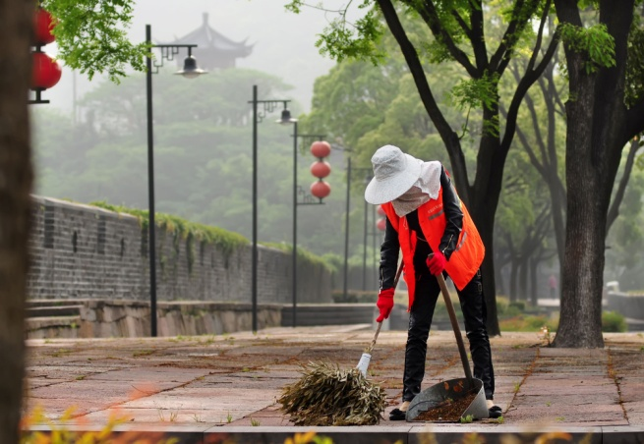


Heroes among us
Section A
The end

